Slide 1
Reading CSV files
Mack 2022
Notes:
Last updated: 11-7-2022

Slide 2
Make a prediction
Starter activity
1 2 3 4 5 6 | players = [["Player name", "Player score"], ["DinoFish", 0], ["SharkDragon", 2]] for item in players: print(item[0])
Questions .
What will be the output of print when this program is executed?
["Player name", "Player score"]
Player name DinoFish SharkDragon
DinoFish SharkDragon
An error will occur
1
▹
2
3
4

Slide 3

Lesson 5: Reading CSV files
Objectives
In this lesson, you will:
Describe a CSV file
Read from a CSV file
Use the split() method
Select data from a collection of values

Slide 4
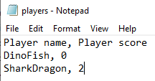
CSV files
Activity 1
CSV stands for comma-separated values.
CSV files can be read by a range of different spreadsheet software packages as well as Python files.

Slide 5
CSV files
Activity 1
Individual item
CSV files contain data structured so that a comma separates individual items in the file, and each record is on a new line of the file.
Each line is a record
Comma separates items

Slide 6
CSV files
Activity 1
A CSV file can be created in a text editor by changing the extension of the file to .csv
You can also create CSV files in spreadsheet software by exporting them as a .csv file.

Slide 7

CSV files
Activity 1
When you open a CSV file in spreadsheet software, the commas are used as a guide to display the data neatly in rows and columns.
When a CSV file is opened in spreadsheet software, it is displayed in tabular format.

Slide 8

CSV files
Activity 1
A CSV file is still a text file. Each row is stored as string.
Modern spreadsheet software will typically recognise a number and store it as that data type.
Python will not do this automatically. Any data is always read as string and will need to be casted before it is used as any other data type.

Slide 9
CSV files
Activity 1
Question .
When do you think you might use a CSV file with your Python programs?

Slide 10
CSV files
Activity 1
Question .
When do you think you might use a CSV file with your Python programs?
Scores for a game
Usernames and passwords
Class register

Slide 11
Reading a CSV file
Activity 2
1 2 3 4 5 | file = open("players.csv", "r") data = file.read() file.close() print(data)
A CSV file is just another text file so you can use all of the same methods that you already know with a CSV file.

Slide 12
Reading a CSV file
Activity 2
1 2 3 4 5 | file = open("players.csv", "r") data = file.read() file.close() print(data)
Using the read() method will copy all of the data into the file in the same way as it did with your text files.
Player name, Player score DinoFish, 0 SharkDragon, 2 >>>

Slide 13
Reading a CSV file
Activity 2
1 2 3 4 5 | file = open("players.csv", "r") data = file.read() file.close() print(data)
The modes are also the same. You can use:
r read
w write
a append
r+ read and write

Slide 14
Reading a CSV file
Activity 2
1 2 3 4 5 | file = open("players.csv", "r") data = file.read() file.close() print(data)
The difference with a CSV file is that you might want to perform different operations with it in comparison to a standard text file.
This means that you need to think carefully about how your data might be structured as it is read into your Python program.

Slide 15
Reading a CSV file
Activity 2
1 2 3 4 5 | file = open("players.csv", "r") data = file.read() file.close() print(data)
Data represented in CSV files is often in tabular form.
This means that it is stored in rows and columns.
Question .
In order to manipulate data that is stored in rows and columns, what data structure might you use?

Slide 16
Reading a CSV file
Activity 2
1 2 3 4 5 | file = open("players.csv", "r") data = file.read() file.close() print(data)
Answer .
A 2D list or a list of records.

Slide 17
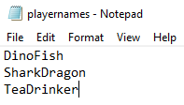
Reading a CSV file
Activity 2
Reading data from a CSV file and holding it in a list is very similar to the method used for standard text files.
Here is a CSV file with one column of data.

Slide 18
Reading a CSV file
Activity 2
1 2 3 | file = open("playernames.csv", "r") data = file.read() file.close()
When you assign the contents of the file to a variable, it is held like this.
State .
data
'DinoFish\n
SharkDragon\n
TeaDrinker'

Slide 19
Reading a CSV file
Activity 2
1 2 3 | file = open("playernames.csv", "r") data = file.read() file.close()
Just as with a standard text file, the \n is included.
State .
data
'DinoFish\n
SharkDragon\n
TeaDrinker'

Slide 20
Reading a CSV file
Activity 2
1 2 3 | file = open("playernames.csv", "r") data = file.read() file.close()
To assign this data to a list data structure, you need to append each line to a list.
State .
data
'DinoFish\n
SharkDragon\n
TeaDrinker'

Slide 21
Reading a CSV file
Activity 2
1 2 3 4 5 | file = open("playernames.csv", "r") data = [] for line in file: data.append(line) file.close()
Question .
What will be held in the data list when this program is executed?
State .
data
['DinoFish\n', 'SharkDragon\n', 'TeaDrinker']

Slide 22
Reading a CSV file
Activity 2
1 2 3 4 5 | file = open("playernames.csv", "r") data = [] for line in file: data.append(line) file.close()
Each item is now in a list, but you still have the extra piece of data to deal with.
State .
data
['DinoFish\n', 'SharkDragon\n', 'TeaDrinker']

Slide 23
Reading a CSV file
Activity 2
1 2 3 4 5 | file = open("playernames.csv", "r") data = [] for line in file: data.append(line) file.close()
Question .
What method can you use to remove unwanted pieces of data?

Slide 24
Reading a CSV file
Activity 2
1 2 3 4 5 | file = open("playernames.csv", "r") data = [] for line in file: data.append(line) file.close()
Question .
What string method can you use to remove unwanted pieces of data?
Answer .
The strip() method.

Slide 25
Reading a CSV file
Activity 2
1 2 3 4 5 6 | file = open("playernames.csv", "r") data = [] for line in file: line = line.strip() data.append(line) file.close()
For each line in the file, you need to strip the "\n".

Slide 26
Reading a CSV file
Activity 2
1 2 3 4 5 6 | file = open("playernames.csv", "r") data = [] for line in file: line = line.strip() data.append(line) file.close()
For each line in the file, you need to strip the "\n".
The strip() method defaults to removing any white space from the start and end of a string, unless you specify the characters as arguments.

Slide 27
Reading a CSV file
Activity 2
1 2 3 4 5 6 | file = open("playernames.csv", "r") data = [] for line in file: line = line.strip() data.append(line) file.close()
You now have a list with all of the extra pieces of data removed.
State .
data
['DinoFish', 'SharkDragon', 'TeaDrinker']

Slide 28
Reading a CSV file
Activity 2
1 2 3 4 5 6 | file = open("playernames.csv", "r") data = [] for line in file: line = line.strip() data.append(line) file.close()
You can now interrogate this data as you would with any other list.
State .
data
['DinoFish', 'SharkDragon', 'TeaDrinker']

Slide 29
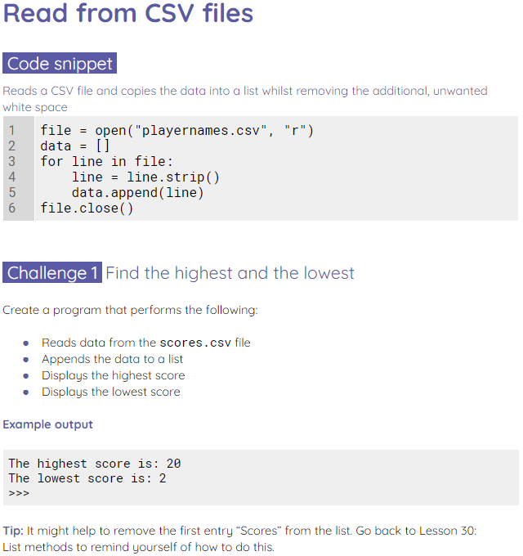
Reading a CSV file
Activity 2
Use the worksheet to read from a CSV file.

Slide 30
Reading a CSV file to a 2D list
Activity 3
CSV files present data in tabular form.
The last example used one column of data.
You are now going to work with a CSV file that has two columns of data.

Slide 31
Reading a CSV file to a 2D list
Activity 3
1 2 3 4 5 6 7 8 9 | file = open("players.csv", "r") data = [] for line in file: line = line.strip() data.append(line) file.close()
The players.csv file has data stored in two columns and three rows.

Slide 32
Reading a CSV file to a 2D list
Activity 3
1 2 3 4 5 6 7 8 9 | file = open("players.csv", "r") data = [] for line in file: line = line.strip() data.append(line) file.close()
If you use the same code as the previous activity with this CSV file, then the data is held in a single list.
State .
data
['Player name, Player score', 'DinoFish, 0', 'SharkDragon, 2']

Slide 33
Reading a CSV file to a 2D list
Activity 3
1 2 3 4 5 6 7 8 9 | file = open("players.csv", "r") data = [] for line in file: line = line.strip() data.append(line) file.close()
Each row in the CSV file is held as an item in the list.
State .
data
['Player name, Player score', 'DinoFish, 0', 'SharkDragon, 2']

Slide 34
Reading a CSV file to a 2D list
Activity 3
1 2 3 4 5 6 7 8 9 | file = open("players.csv", "r") data = [] for line in file: line = line.strip() data.append(line) file.close()
Each row in the CSV file is held as an item in the list.
State .
data
['Player name, Player score', 'DinoFish, 0', 'SharkDragon, 2']

Slide 35
Reading a CSV file to a 2D list
Activity 3
1 2 3 4 5 6 7 8 9 | file = open("players.csv", "r") data = [] for line in file: line = line.strip() data.append(line) file.close()
Each row in the CSV file is held as an item in the list.
State .
data
['Player name, Player score', 'DinoFish, 0', 'SharkDragon, 2']

Slide 36
Reading a CSV file to a 2D list
Activity 3
1 2 3 4 5 6 7 8 9 | file = open("players.csv", "r") data = [] for line in file: line = line.strip() data.append(line) file.close()
This means that each item has two pieces of data held within it.
This isn’t practical.
State .
data
['Player name, Player score', 'DinoFish, 0', 'SharkDragon, 2']
1
2

Slide 37

Reading a CSV file to a 2D list
Activity 3
1 2 3 4 5 6 7 8 9 | file = open("players.csv", "r") data = [] for line in file: line = line.strip() data.append(line) file.close()
This means that each item has two pieces of data held within it.
This isn’t practical.
State .
Note that the commas from the CSV file are part of the string here and are not separating items in the list.
data
['Player name, Player score', 'DinoFish, 0', 'SharkDragon, 2']
1
2

Slide 38
Reading a CSV file to a 2D list
Activity 3
1 2 3 4 5 6 7 8 9 | file = open("players.csv", "r") data = [] for line in file: line = line.strip() data.append(line) file.close()
For each piece of data to be held as an item, the data needs to be split at the comma in each line.
State .
data
['Player name, Player score', 'DinoFish, 0', 'SharkDragon, 2']

Slide 39
The split() method
Activity 3
1 2 | words = "here are lots of words" words = words.split(" ")
The split() method takes a string and splits it into a list of items.
State .
words

Slide 40
The split() method
Activity 3
1 2 | words = "here are lots of words" words = words.split(" ")
The words variable holds a string of words.
State .
words
here are lots of words

Slide 41
The split() method
Activity 3
1 2 | words = "here are lots of words" words = words.split(" ")
The split() method splits the string where it finds a space " " and returns it in a list.
State .
words
['here',
'are',
'lots',
'of',
'words']

Slide 42
The split() method
Activity 3
1 2 | words = "here are lots of words" words = words.split(" ")
The character that is passed as an argument into the method will be used to split the string.
State .
words
['here',
'are',
'lots',
'of',
'words']

Slide 43
The split() method
Activity 3
1 2 | words = "here are lots of words" words = words.split("o")
Changing the space to an o will result in a different list.
State .
words
['here are l',
'ts ',
'f w',
'rds']

Slide 44
The split() method
Activity 3
1 2 | words = "here are lots of words" words = words.split("o")
Changing the space to an o will result in a different list.
Note that the letter o is also removed from the string.
State .
words
['here are l',
'ts ',
'f w',
'rds']

Slide 45
Reading a CSV file to a 2D list
Activity 3
1 2 3 4 5 6 7 8 9 | file = open("players.csv", "r") data = [] for line in file: line = line.strip() data.append(line) file.close()
Question .
How might the split() method help with our CSV file?

Slide 46
Reading a CSV file to a 2D list
Activity 3
1 2 3 4 5 6 7 8 9 | file = open("players.csv", "r") data = [] for line in file: line = line.strip() data.append(line) file.close()
Question .
How might the split() method help with our CSV file?
Answer .
It can split each line when it finds a comma.

Slide 47
Reading a CSV file to a 2D list
Activity 3
1 2 3 4 5 6 7 8 9 10 | file = open("players.csv", "r") data = [] for line in file: line = line.strip() line = line.split(",") data.append(line) file.close()
By splitting each line into a list, you now have a 2D list.
State .
data
[['Player name', ' Player score'],
['DinoFish', ' 0'],
['SharkDragon', ' 2']]

Slide 48
Reading a CSV file to a 2D list
Activity 3
1 2 3 4 5 6 7 8 9 10 | file = open("players.csv", "r") data = [] for line in file: line = line.strip() line = line.split(",") data.append(line) file.close()
This will now allow you to perform operations on the data.
State .
data
[['Player name', ' Player score'],
['DinoFish', ' 0'],
['SharkDragon', ' 2']]

Slide 49
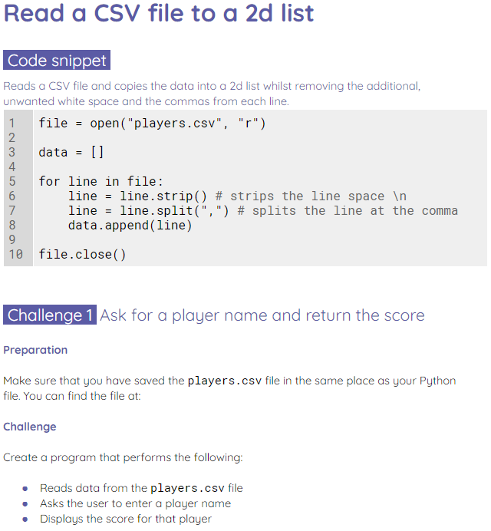
Reading a CSV file to a 2D list
Activity 3
Use the worksheet to read data into a 2D list.

Slide 50
Activity 3 solutions
Plenary
1 2 3 4 5 6 7 8 9 10 11 12 13 14 15 16 17 18 19 20 21 22 23 | file = open("players.csv", "r") data = [] for line in file: line = line.strip() line = line.split(",") data.append(line) file.close() print("Enter a player name:") player = input() playerlocation = "" for item in data: if player in item: location = (data.index(item)) score = data[location][1] print(f"The last score for {player} was {score}")

Slide 51
Activity 3 solutions
Plenary
1 2 3 4 5 6 7 8 9 10 11 12 13 14 15 16 17 18 19 20 21 22 23 24 25 | file = open("weatherdata.csv", "r") data = [] for line in file: line = line.strip() line = line.split(",") data.append(line) file.close() data.pop(0) datalength = len(data) for x in range(datalength): rainfall = data[x][5] data[x][5] = float(rainfall) highestrainfall = 0 for x in range(datalength): if data[x][5] > highestrainfall: highestrainfall = data[x][5] timestamp = data[x][0] print(f"Highest recorded rainfall: {highestrainfall} on {timestamp}")

Slide 52
Next lesson
Summary
In this lesson, you…
Learnt how to read CSV files and interrogate the data within them
Next lesson, you will…
Write to a CSV file

